Slide 1

HIRE-TO-RETIRE PEOPLE ANALYTICS
Strategic Workforce Turnaround
Solving the Attrition Crisis Through Data-Driven HR Insights
Employee Master · Recruitment · Performance · Lifecycle & Retention · Monthly Pulse
FY2018 – FY2026

Slide 2



THE CRISIS
58.4% of our workforce has walked out the door.
Attrition is now the single biggest threat to operational continuity. Nearly six in ten employees hired since 2018 have already resigned or been terminated — and the data shows exactly where, and why.
58.4%
22.3 mo
95.8 days
Attrition Rate
Avg. Tenure
Avg. Time to Fill a Role
Strategic Workforce Turnaround
2

Slide 3
HR is shifting from “Reactive” to “Predictive” people management.
Where ADT's HR model stands today versus the 2026 industry standard.
Feature | The “Old” Way (Today) | The “2026” Way (Target)
Strategy | React after employees resign | Predict flight risk before it happens
Data | Siloed spreadsheets, one per department | Unified hire-to-retire analytics platform
Manager Quality | Gut-feel performance reviews | Manager Effect Scores tracked systematically
Compensation | Annual, backward-looking pay reviews | Continuous benchmarking vs. market rate
Goal | Fill the seat | Retain the right people, sustainably
Strategic Workforce Turnaround
3

Slide 4

ROOT CAUSE
1 in 7 employees reports to a “bad manager” — and it shows.
3,707 employees (14.8% of the workforce) are managed by someone flagged as a below-benchmark performer. The retention gap is stark:
Under Bad Managers
Under Strong Managers
Termination Rate
Termination Rate
68.0%
56.7%
Avg. Tenure
Avg. Tenure
18.4 months
23.0 months
Attrition Risk Score
Attrition Risk Score
59.6 / 100
52.7 / 100
Strategic Workforce Turnaround
4

Slide 5

HR and Operations carry the highest flight-risk exposure.
Average Attrition Risk Score by department (0–100 scale).
54.04
HR's own attrition risk score is the highest in the company — the function tasked with fixing turnover is itself the most exposed.
Read on the chart
Risk is broadly distributed — every department sits within a tight 0.6-point band. This is a systemic issue (pay, management quality), not a single department's problem.
Strategic Workforce Turnaround
5

Slide 6

COMPENSATION
Underpaying against market is the strongest single predictor of attrition risk.
-0.60
correlation between pay-vs-market and attrition risk, at the individual employee level
+6.0%
average pay vs. market across the company — but the gap varies sharply by department
Strategic Workforce Turnaround
6

Slide 7

Two-thirds of exits are preventable — better offers and disengagement lead the list.
Primary drivers behind 14,592 employee exits.
Voluntary — Better Offer
34.7%
91.2%
Voluntary — Personal
28.6%
of exits are voluntary — people are choosing to leave, not being managed out.
Voluntary — Low Engagement
28%
Better offers and low engagement together account for 62.7% of exits — both are directly addressable through pay and manager quality.
Involuntary — Restructure
6.7%
Involuntary — Performance
2.1%
Strategic Workforce Turnaround
7

Slide 8


RECRUITING VELOCITY
It takes 96 days to fill a role — nearly double a healthy benchmark.
Slow, costly hiring compounds the retention problem — vacant seats sit open while the people covering them burn out.
95.8
$72.2K
$1.72B
Avg. Days to Fill a Role
Avg. Acquisition Cost per Hire
Total Cost of Vacancy
vs. ~45-day industry benchmark
sourcing + agency + internal cost
across all filled requisitions to date
Strategic Workforce Turnaround
8

Slide 9
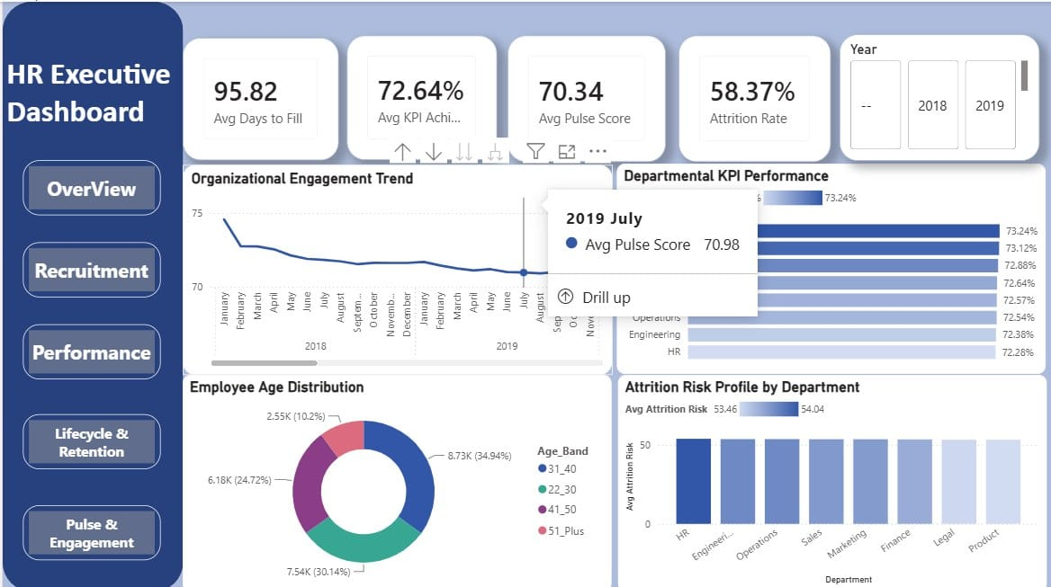
LIVE DASHBOARD — OVERVIEW
One click traces 58.37% attrition back to its source.
The Overview page lets leadership drill from a single company-wide number into engagement trends, department KPIs, and age distribution in seconds. Employees aged 22–40 make up roughly two-thirds of the workforce — the most mobile, most flight-risk segment of all.
65%
of employees are under age 40
Strategic Workforce Turnaround
9

Slide 10
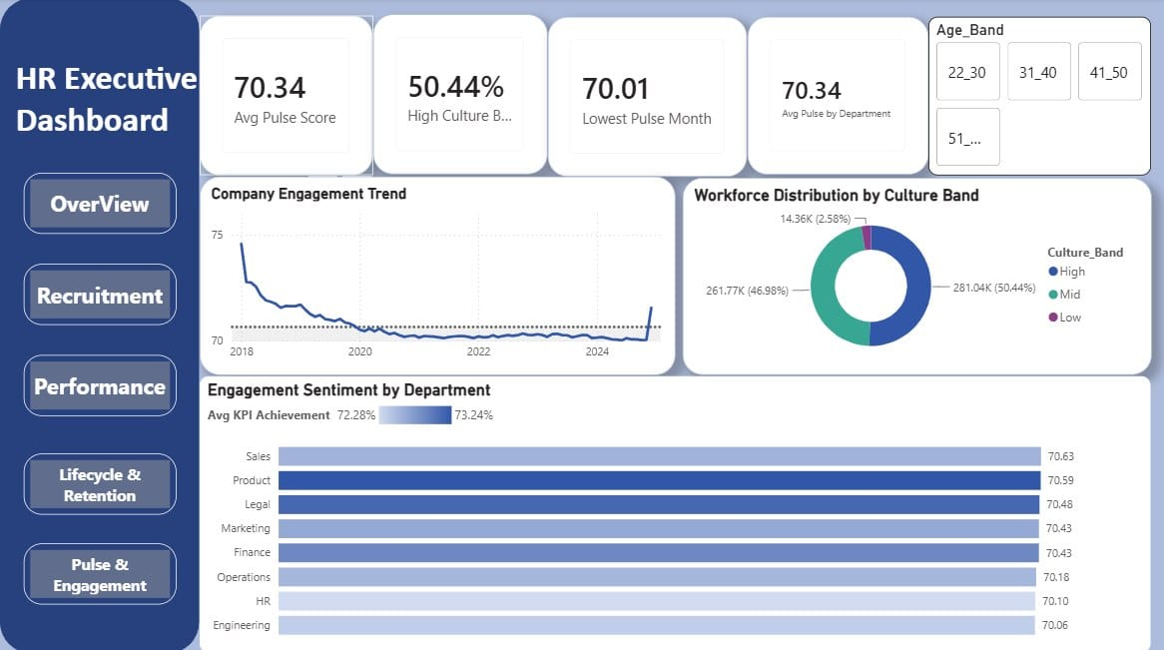
LIVE DASHBOARD — PULSE & ENGAGEMENT
Engagement cratered in 2018 and has flatlined ever since.
Half the workforce (50.4%) now sits in the High Culture Band, but Engineering and HR post the lowest sentiment scores of any function — the same two teams already flagged as highest flight-risk in the retention analysis.
70.34
avg. pulse score, essentially unchanged since 2019
Strategic Workforce Turnaround
10

Slide 11
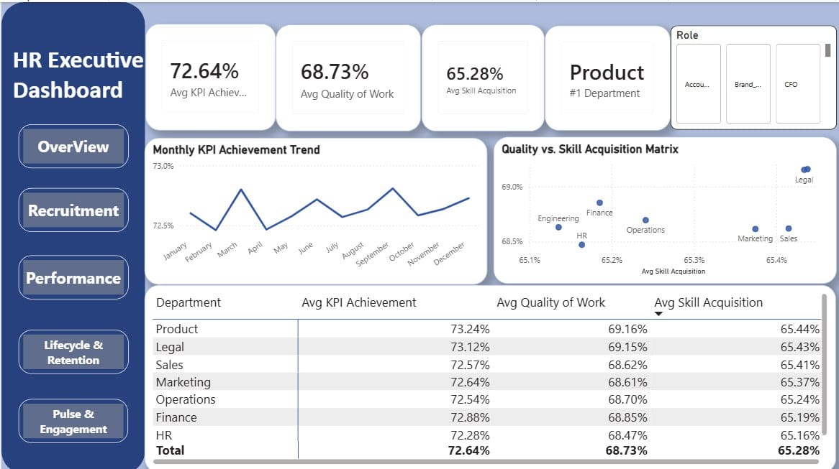
LIVE DASHBOARD — PERFORMANCE
Skill acquisition is the weakest link in the performance story.
KPI Achievement (72.6%) and Quality of Work (68.7%) are respectable, but Skill Acquisition trails at just 65.3% — even in Legal and Product, the two strongest-performing departments. Growth investment isn't keeping pace with output.
65.3%
avg. skill acquisition — the lowest of the three metrics
Strategic Workforce Turnaround
11

Slide 12
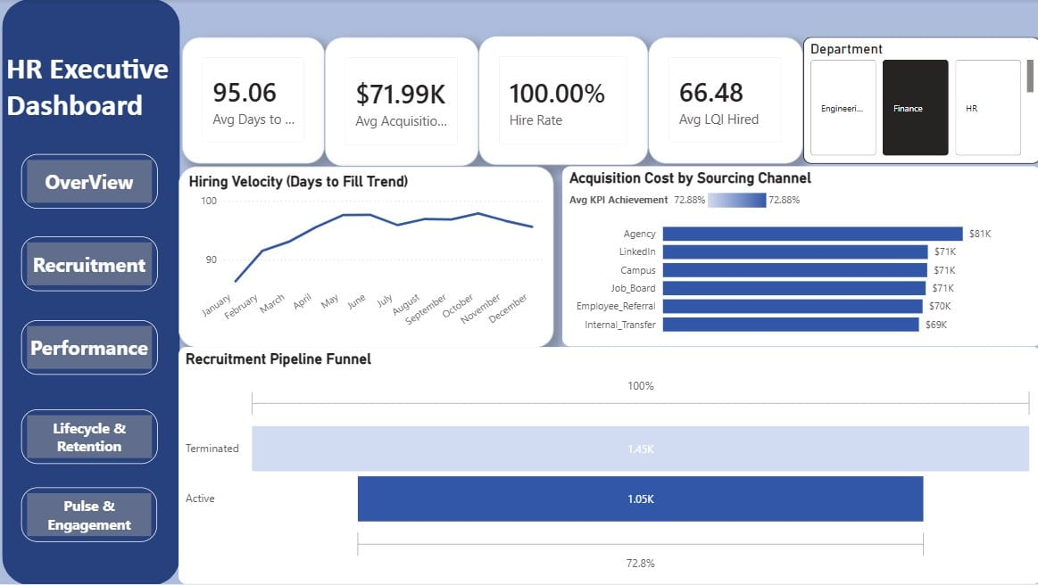
LIVE DASHBOARD — RECRUITMENT
Agency hires cost far more than every other channel — with no quality premium.
At $81K per hire, Agency is the most expensive sourcing channel, while Internal Transfer costs just $69K for a comparable outcome. Hiring velocity has also crept up through the year, climbing from 88 days in January toward a peak near 96.
$81K
avg. cost per Agency hire vs. $69–71K elsewhere
Strategic Workforce Turnaround
12

Slide 13
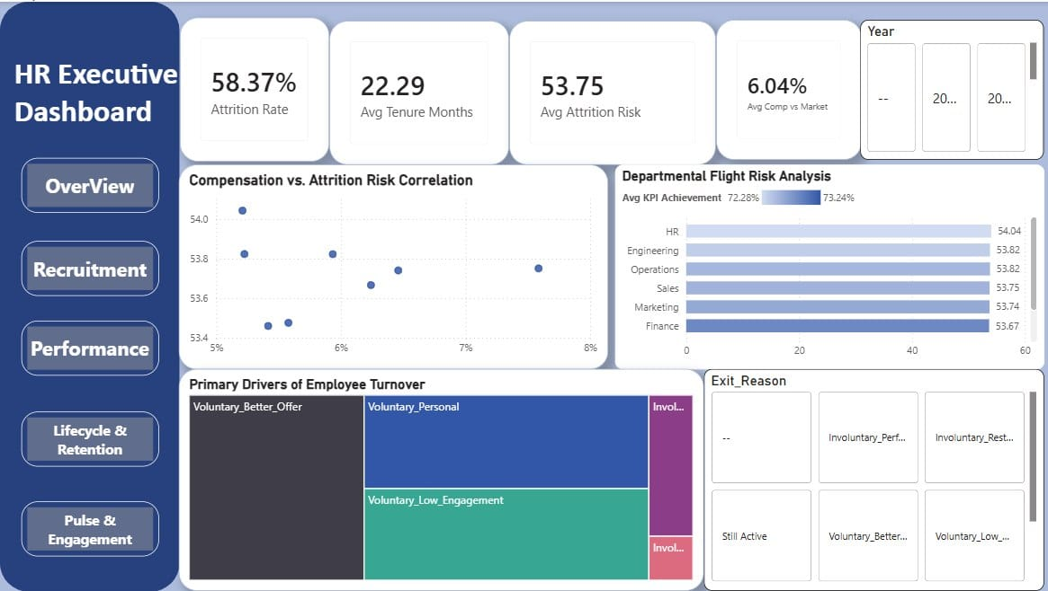
LIVE DASHBOARD — LIFECYCLE & RETENTION
The dashboard confirms it: a systemic, company-wide retention problem.
HR still shows the highest departmental flight risk (54.04), and the turnover treemap makes the mix visible at a glance — voluntary exits from better offers and disengagement dwarf every involuntary category combined.
53.4–54.0
attrition risk band spanning every department
Strategic Workforce Turnaround
13

Slide 14



Three steps to stabilize the workforce.
01
02
03
Manager Accountability Program
Close the Pay Gap
Compress Time-to-Fill
Coach or replace the 14.8% of managers whose teams show elevated attrition. Tie manager scorecards directly to retention outcomes, not just output.
Run quarterly comp-vs-market benchmarking for high-risk departments — starting with HR and Operations — to neutralize the strongest predictor of attrition.
Redesign the recruiting pipeline to cut the 96-day average fill time toward a 45-day benchmark, reducing vacancy cost and hiring-manager burnout.
Strategic Workforce Turnaround
14

Slide 15

Thank You
Questions & discussion welcome.

